Slide 1


Slide 2
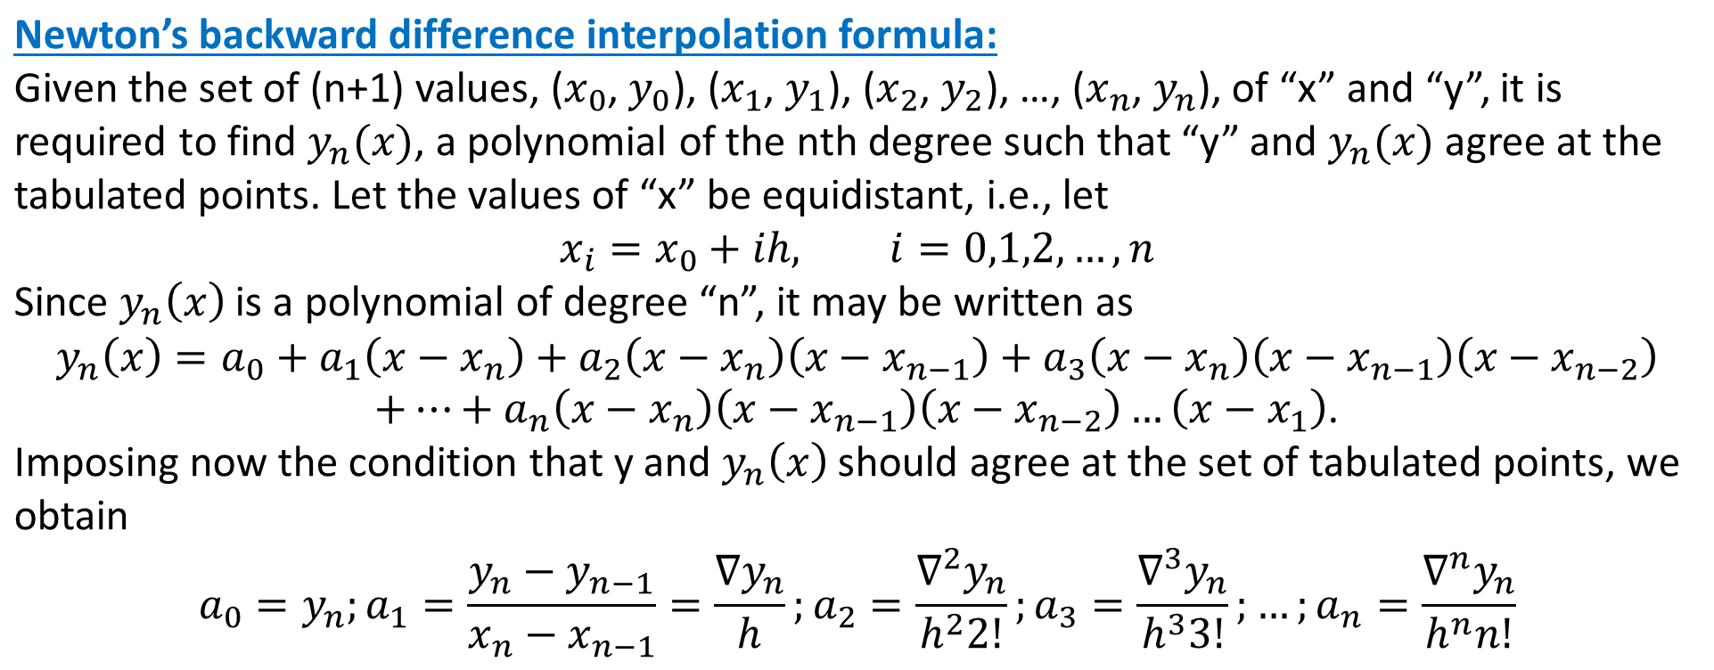

Numerical Methods
National University of Science and Technology, Islamabad

Slide 3
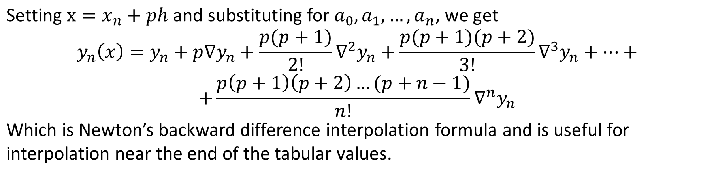
Numerical Methods
National University of Science and Technology, Islamabad

Slide 4
Numerical Methods
Class Task:
Find the polynomial which approximate the following values by using
Newton’s backward difference interpolations formula and then
evaluate y(5.5):
y(3) = 13, y(4) = 21, y(5) = 31, and y(6) = 43.
National University of Science and Technology, Islamabad

Slide 5
Numerical Methods
Home Task
Attempt all problem related to Forward difference interpolation and Backward difference interpolation formulas.
National University of Science and Technology, Islamabad

Slide 6

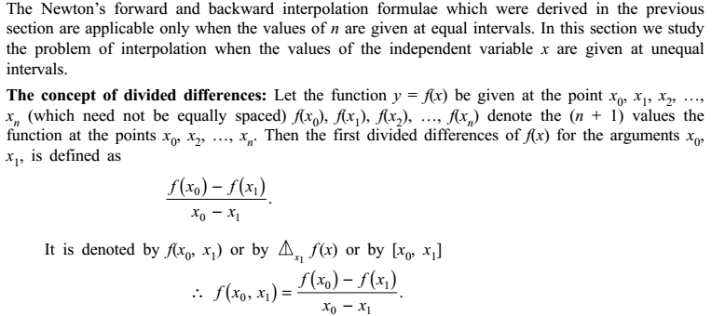
Numerical Methods
National University of Science and Technology, Islamabad

Slide 7
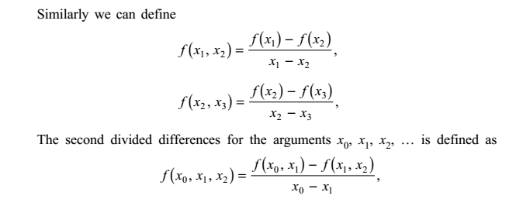
Numerical Methods
National University of Science and Technology, Islamabad

Slide 8
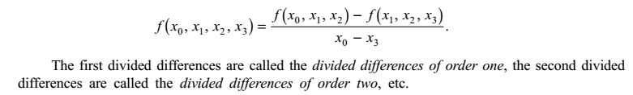
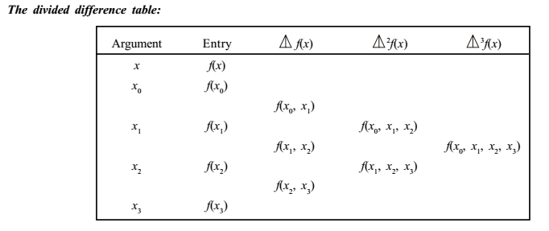
Numerical Methods
National University of Science and Technology, Islamabad

Slide 9
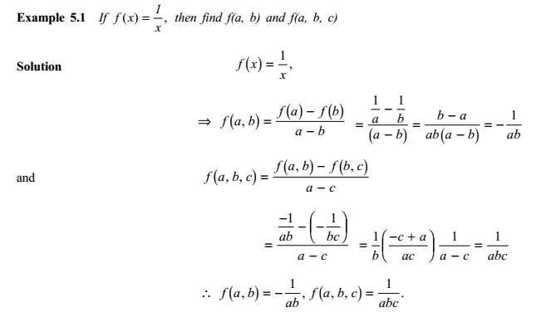
Numerical Methods
National University of Science and Technology, Islamabad

Slide 10

Numerical Methods
National University of Science and Technology, Islamabad

Slide 11

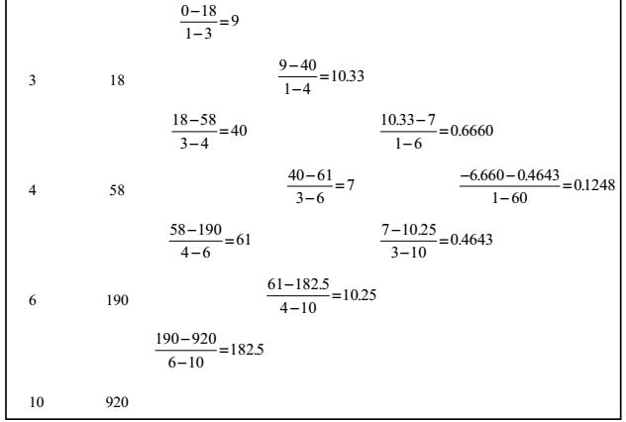
Numerical Methods
National University of Science and Technology, Islamabad

Slide 12
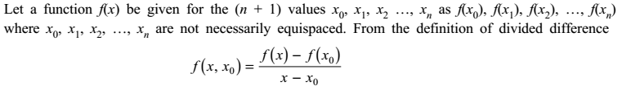
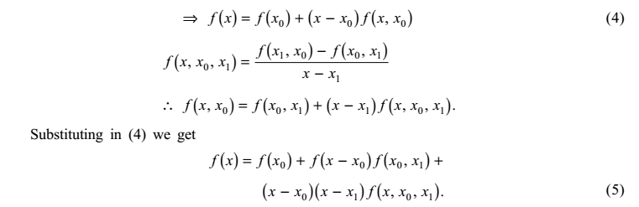
Numerical Methods
National University of Science and Technology, Islamabad

Slide 13
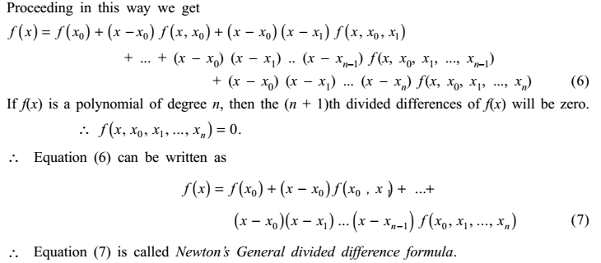
Numerical Methods
National University of Science and Technology, Islamabad

Slide 14
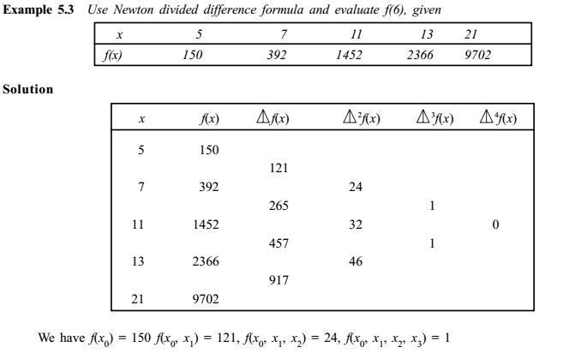
Numerical Methods
National University of Science and Technology, Islamabad

Slide 15
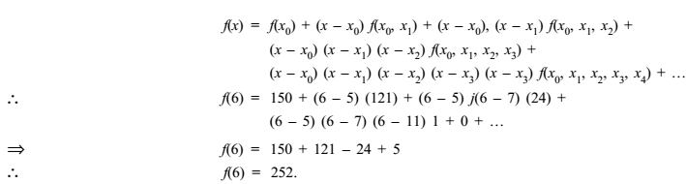
Numerical Methods
National University of Science and Technology, Islamabad

Slide 16

Numerical Methods
National University of Science and Technology, Islamabad

Slide 17
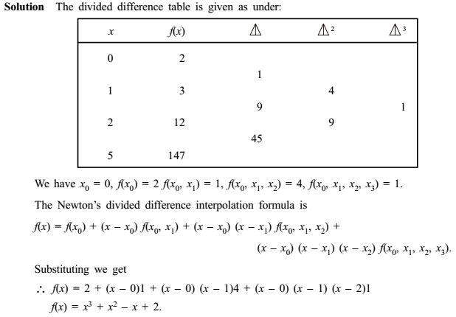
Numerical Methods
National University of Science and Technology, Islamabad

Slide 18
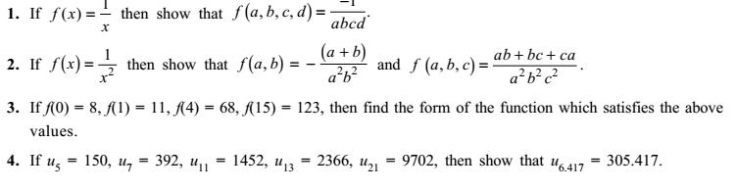
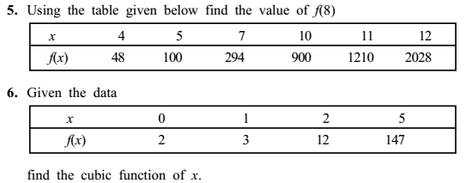
Numerical Methods
National University of Science and Technology, Islamabad

